Slide 1
Principles of Anatomy and Physiology
Gerard Tortora and Bryan Derrickson
Sixteenth Edition
Chapter 5
The Integumentary System
This slide deck contains animations. Please disable animations if they cause issues with your device.
Copyright ©2021 John Wiley & Sons, Inc.

Slide 2
Introduction
The purpose of the chapter is to:
Describe the structure and functions of the skin
Layers of epidermis and dermis
Types of cells in skin
Distinguish accessory structures and different gland of skin
Describe the anatomy of hair and nails

Slide 3
Animation
The Integumentary System
Notes:
You must be connected to the Internet and in Slideshow Mode to run this animation.

Slide 4
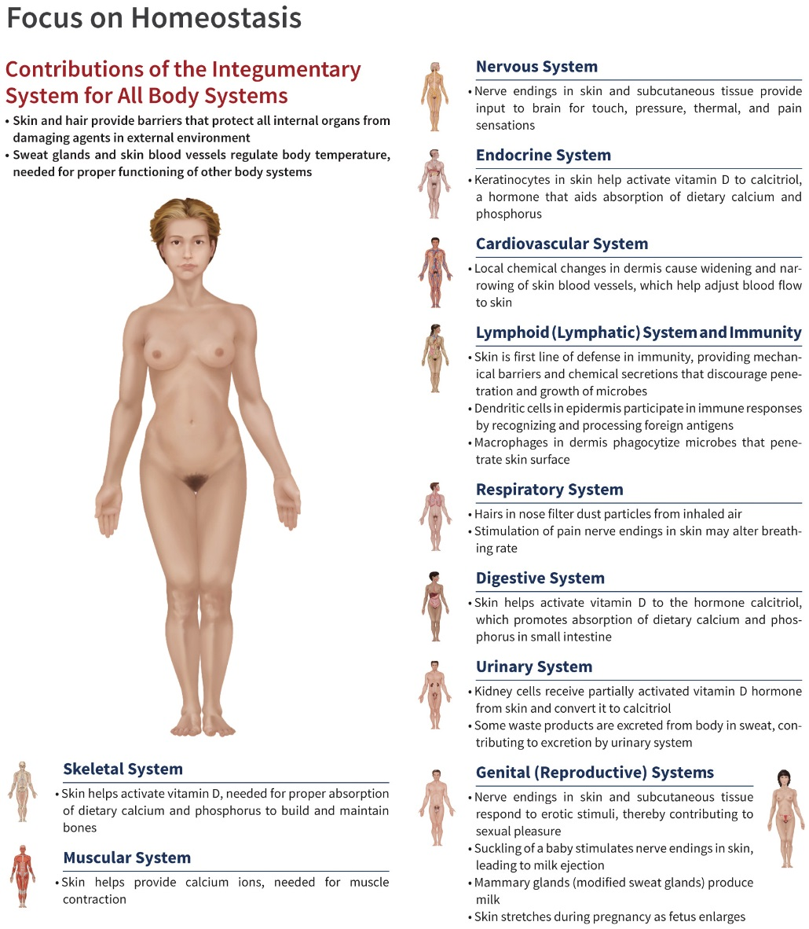
Maintenance of Homeostasis

Slide 5
Structure of the Skin

Slide 6
Layers of the Skin
The skin has 2 major layers:
Epidermis – the most superficial layer
Dermis – layer deep to the epidermis
Hypodermis – also called the subcutaneous (subQ) layer; located deep to the dermis but not a layer of the skin
Composed of areolar and adipose tissue

Slide 7
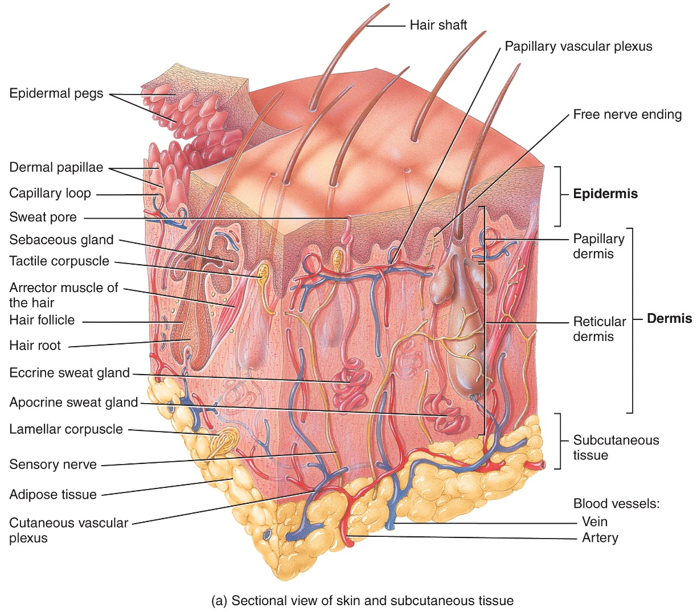
Components of the Integumentary System

Slide 8
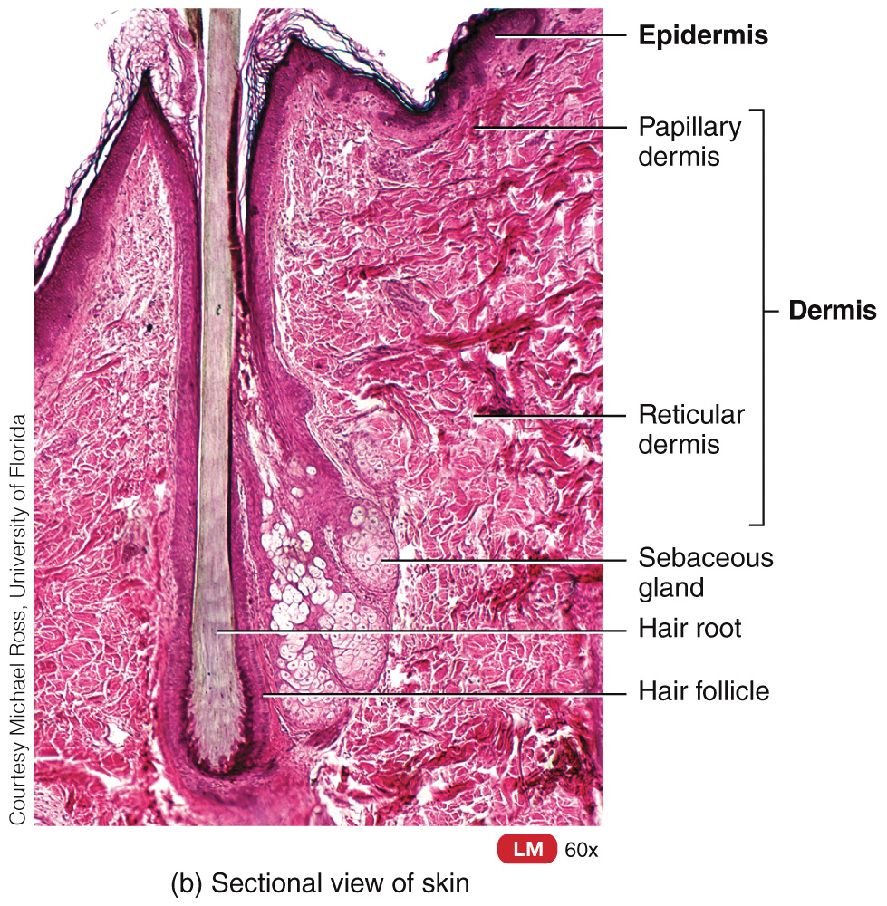
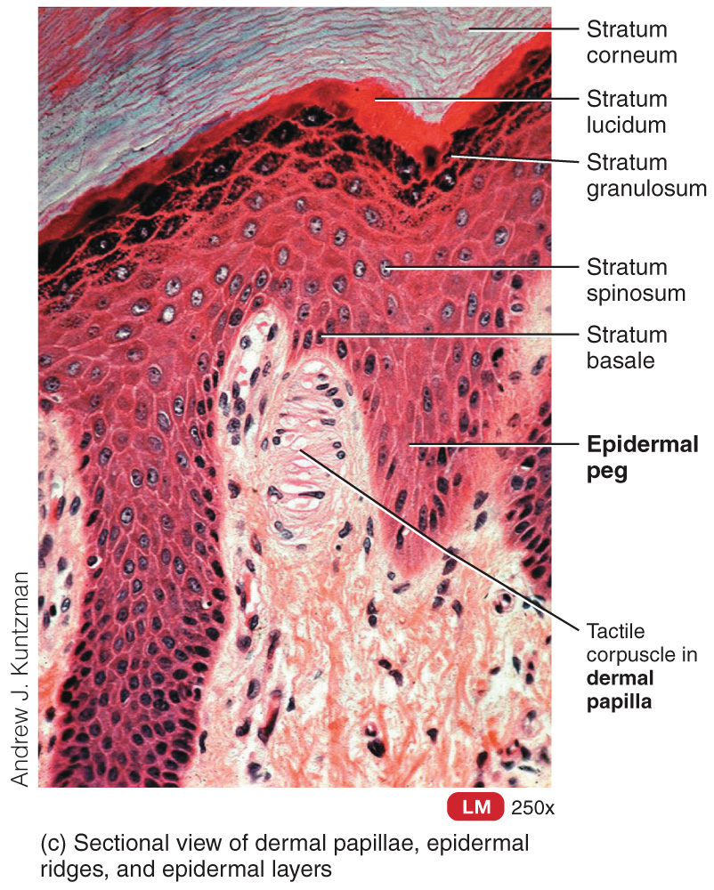
Components of the Integumentary System

Slide 9
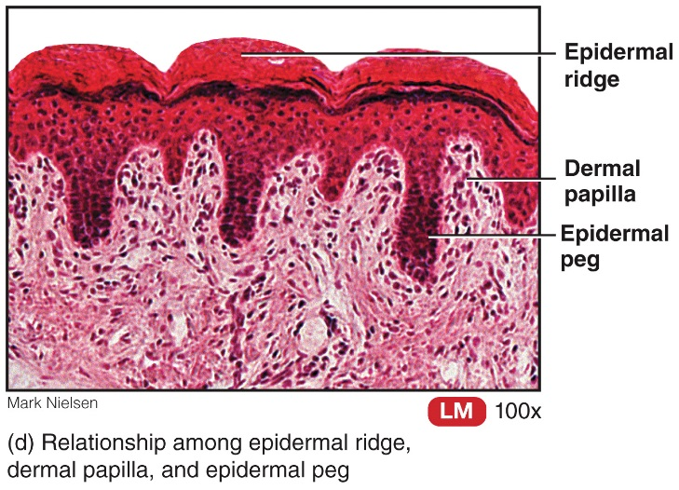
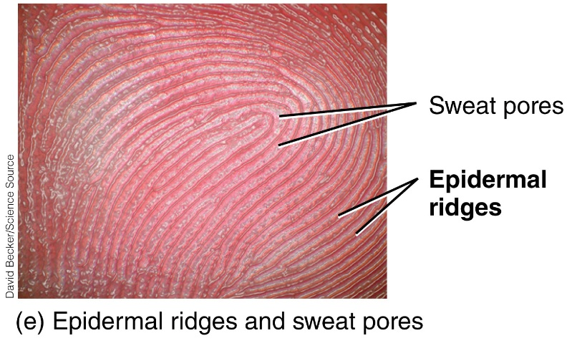
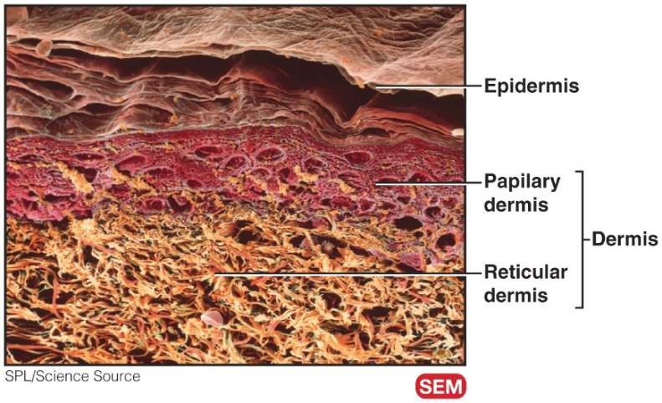
Components of the Integumentary System

Slide 10
The Epidermis
Four major types of cells
Keratinocytes
Produce fibrous protein keratin
Melanocytes
Produce melanin
Intradermal macrophages (Langerhans cells)
Helps activate immune system
Tactile epithelial cells (Merkel cells)
Touch receptors

Slide 11
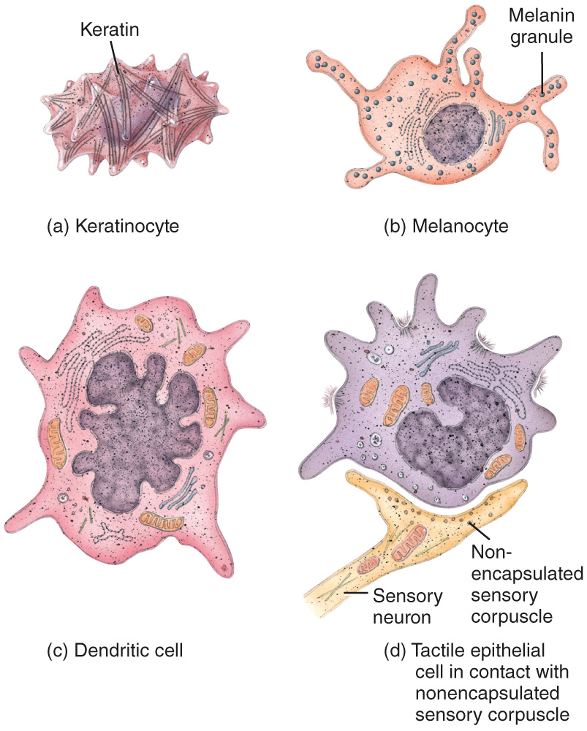
The Epidermis

Slide 12
The Epidermis
Types of skin:
Thin skin
Has hair
Covers all body regions except the palms, palmar surfaces of digits, and soles
Thick skin
Does not have hair
Covers palms, palmar surfaces of digits, and soles

Slide 13
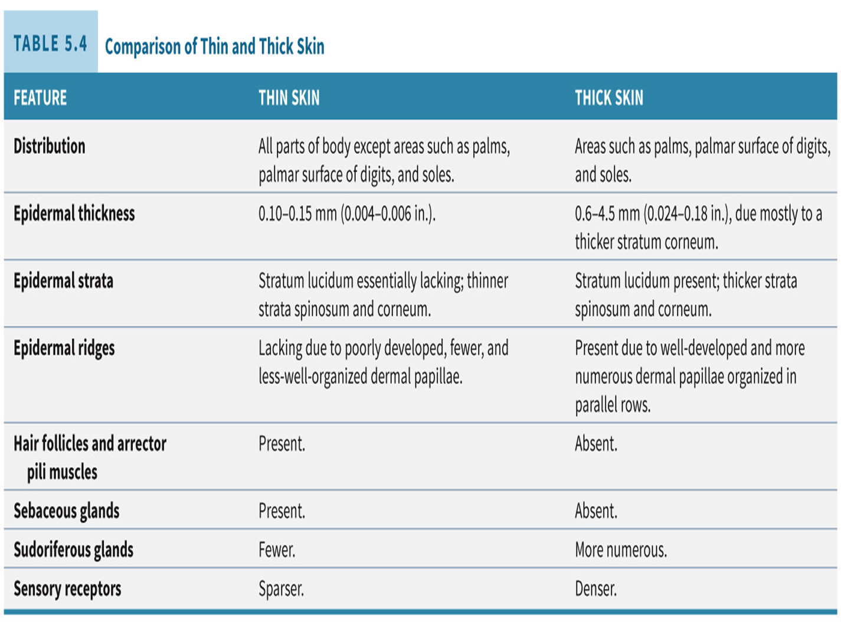

Slide 14
The Epidermis
The epidermis is composed of four layers in thin skin and five layers in thick skin. They are (from deep to superficial):
The stratum basale
The stratum spinosum
The stratum granulosum
The stratum lucidum (only present in thick skin)
The stratum corneum

Slide 15
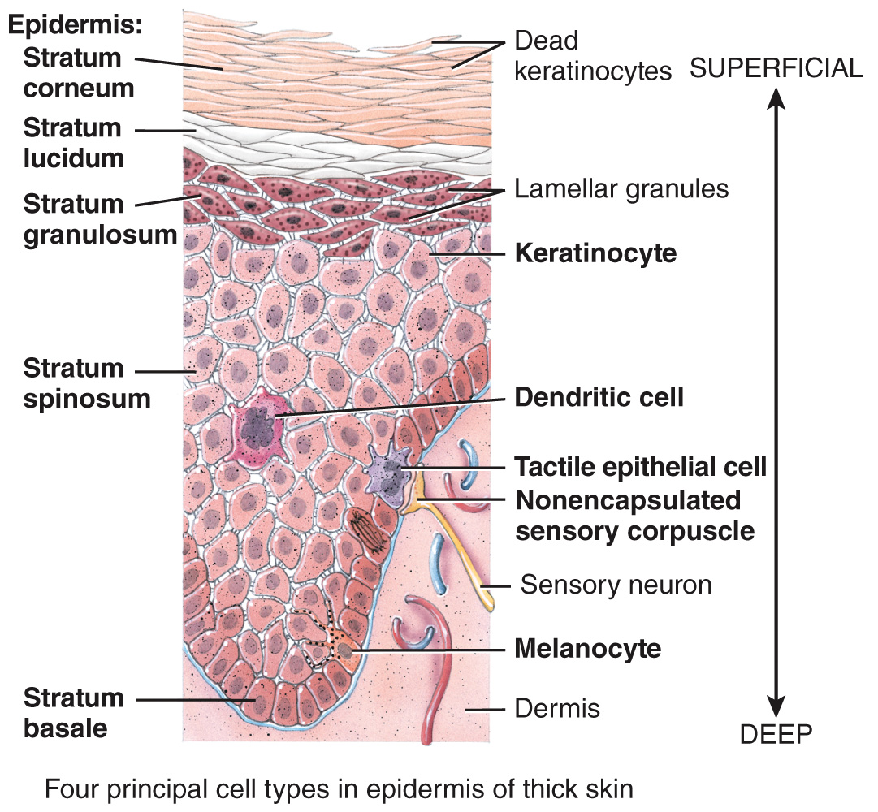
The Epidermis

Slide 16
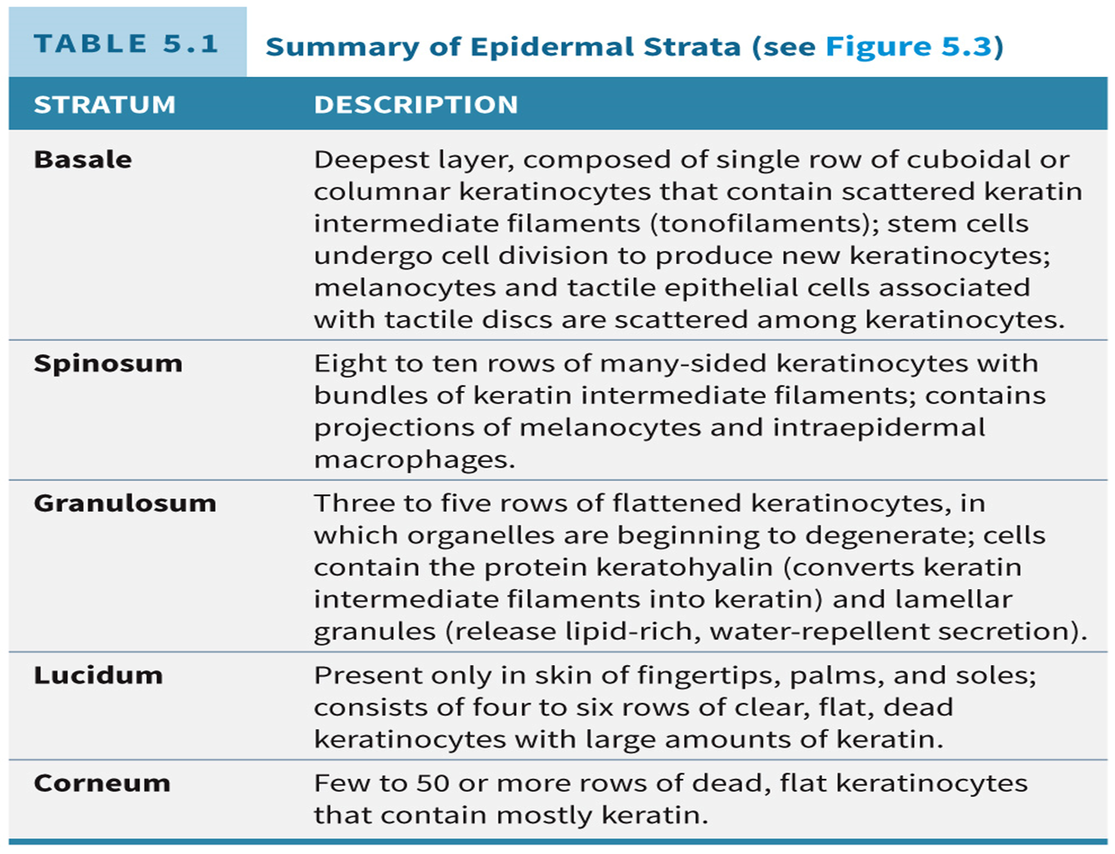

Slide 17
Dermis
Two layers
Papillary
Superficial; areolar connective tissue
Dermal papillae contain:
Capillary loops, Meissner’s corpuscles, free nerve endings
Reticular
Deep; dense irregular connective tissue
Pacinian corpuscles
Abundant blood supply – nutrients diffuse to deep layers of epidermis; waste diffused from epidermis

Slide 18
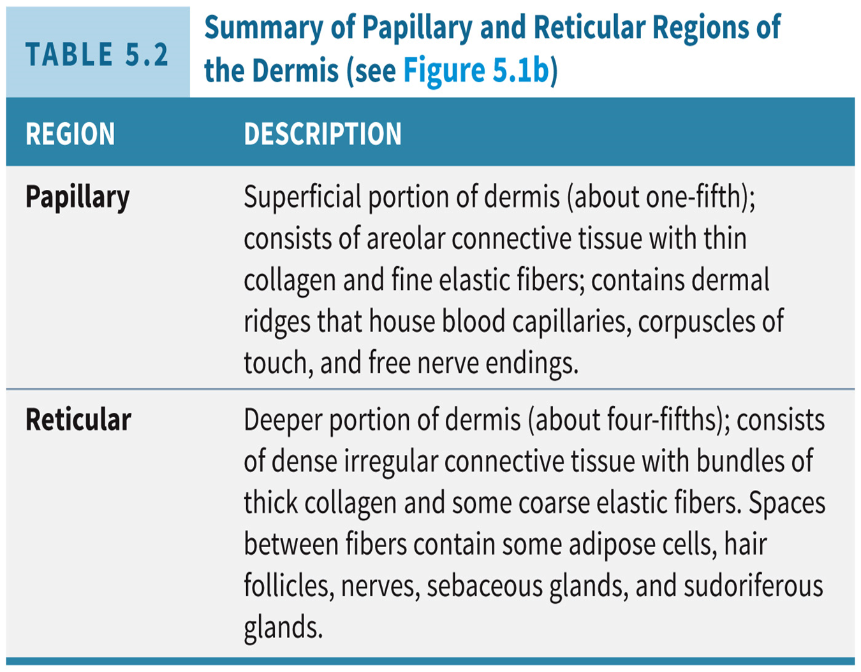

Slide 19
Skin Pigments
Melanin - produced by melanocytes in the stratum basale
Pheomelanin (yellow to red)
Eumelanin (brown to black)
Hemoglobin – red pigment in red blood cells
Carotene – yellow-orange pigment stored in the stratum corneum and adipose tissue

Slide 20
Clinical Connection: Albinism and Vitiligo
Albinism
Genetic trait characterized by complete or partial absence of pigment in skin, hair, and eyes
Due to enzyme involved with melanin production
Vitiligo
Results in depigmentation patches in the skin
Exact cause is unknown; most likely due to combination of genetic factors coupled with a disfunction of the immune system

Slide 21
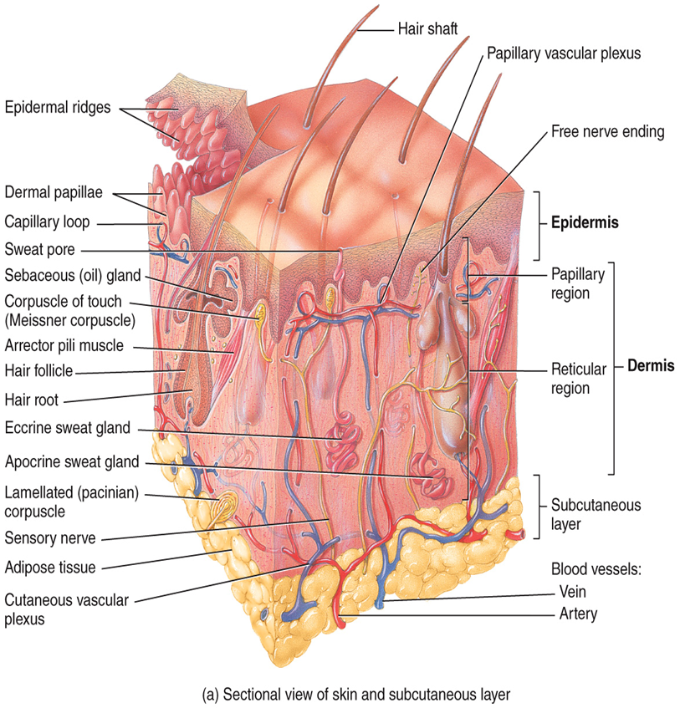
Hypodermis
The subcutaneous layer
Attaches skin to underlying tissues and organs

Slide 22
Accessory Structures of the Skin

Slide 23
Hair
Present on most body surfaces except the nipples, the palms, palmar surfaces of fingers, the soles, plantar surfaces of the toes, labia minora and prepuce of penis
Composed of dead, keratinized epidermal cells bonded by extracellular proteins
Genetic and hormonal influences determine the thickness and distribution of our hair

Slide 24
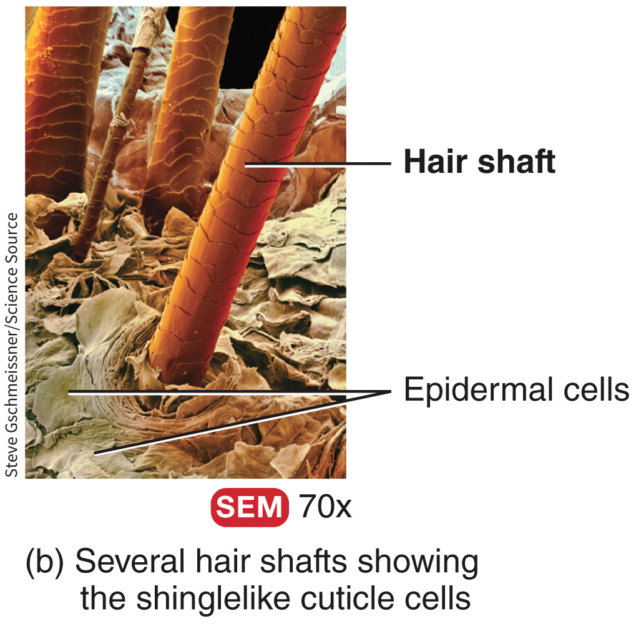
Hair
The parts of a hair include:
The shaft (above the skin surface)
The follicle (below the level of the skin)
A root that penetrates into the dermis
Epithelial root sheath
Dermal root sheath

Slide 25
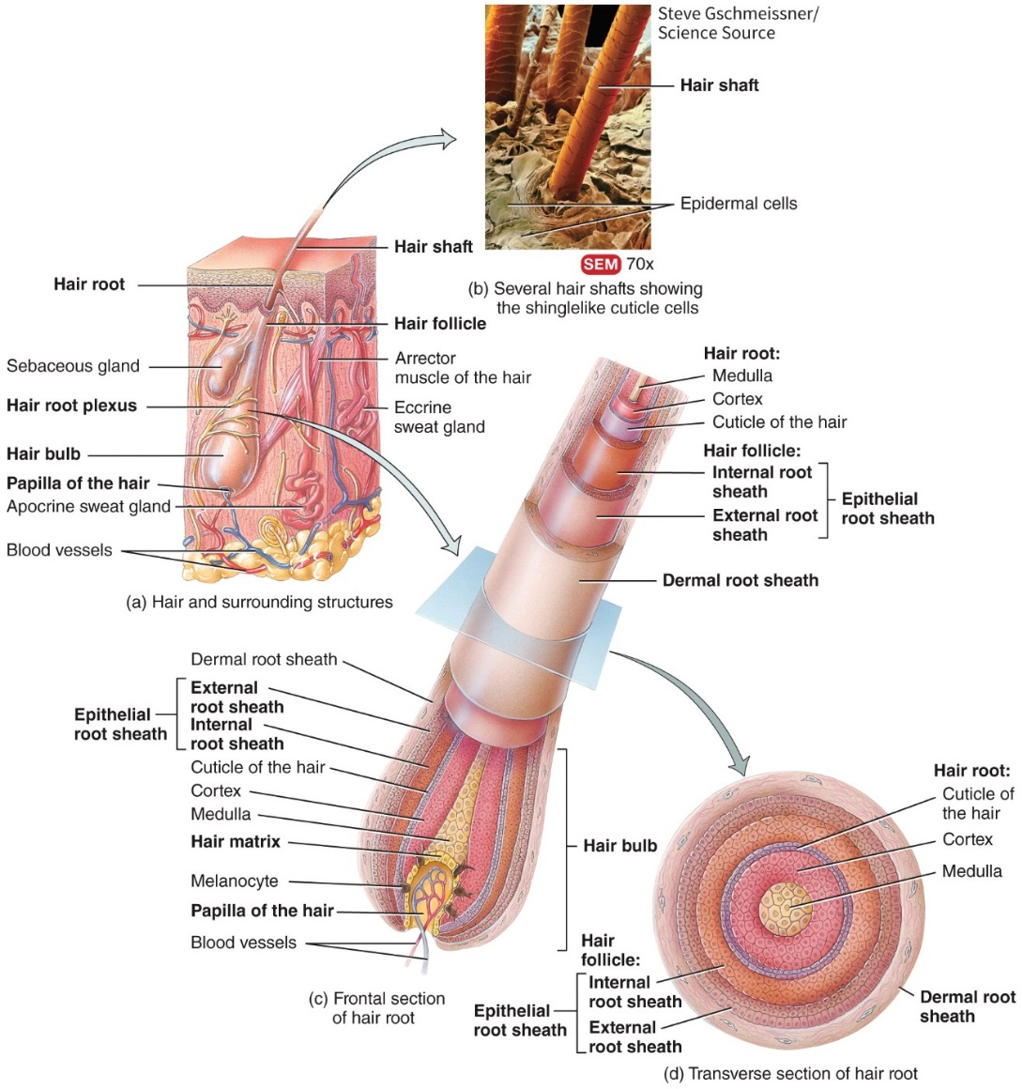
Hair

Slide 26
Hair Growth
Hair growth stages are:
Growth stage – cells of matrix divide
Regression stage – hair moves away from blood supply in papillary and follicle atrophies
Resting stage – old hair root falls out; new growth begins

Slide 27
Types of Hairs
Lanugo – cover the fetus
Terminal – long, coarse, heavily pigmented hairs
Vellus – short, fine, pale hairs

Slide 28
Hair Color
Hair color is primarily due to the amount and type of melanin present in the keratinized cells of the hair
Dark-colored hair – mostly eumelanin
Blond and red hair – variants of phenomelanin
Gray hair – progressive decline in melanin production
White hair – lack of melanin; accumulation of air bubbles in shaft

Slide 29
Skin Glands
The skin contains 3 types of glands
Sebaceous (oil) glands are connected to hair follicles
Sudoriferous glands are sweat glands
Eccrine are the most numerous
Ducts connect to pores
Function in thermoregulation
Apocrine are located mainly in hairy skin areas
Ducts connect to hair follicles
Axillary and pubic regions
Ceruminous glands are modified sweat glands located in the ear canal

Slide 30
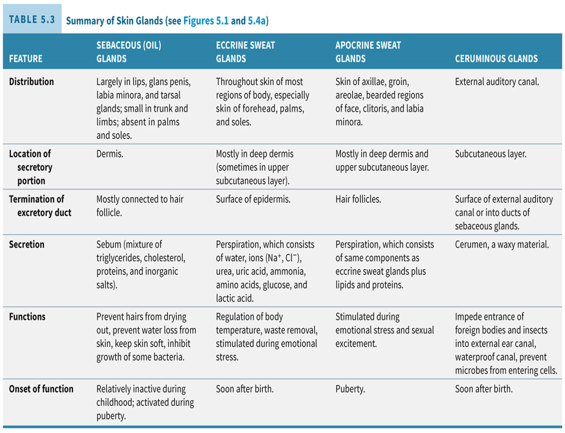

Slide 31
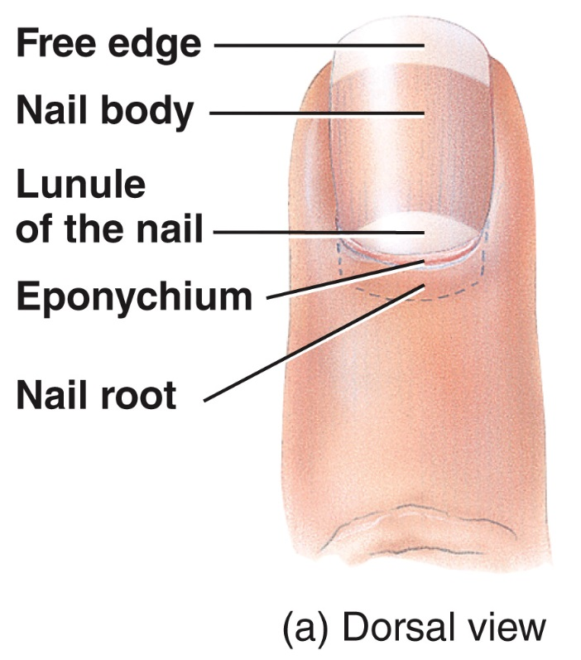
Nails
Nails are made of keratinized epidermal cells

Slide 32
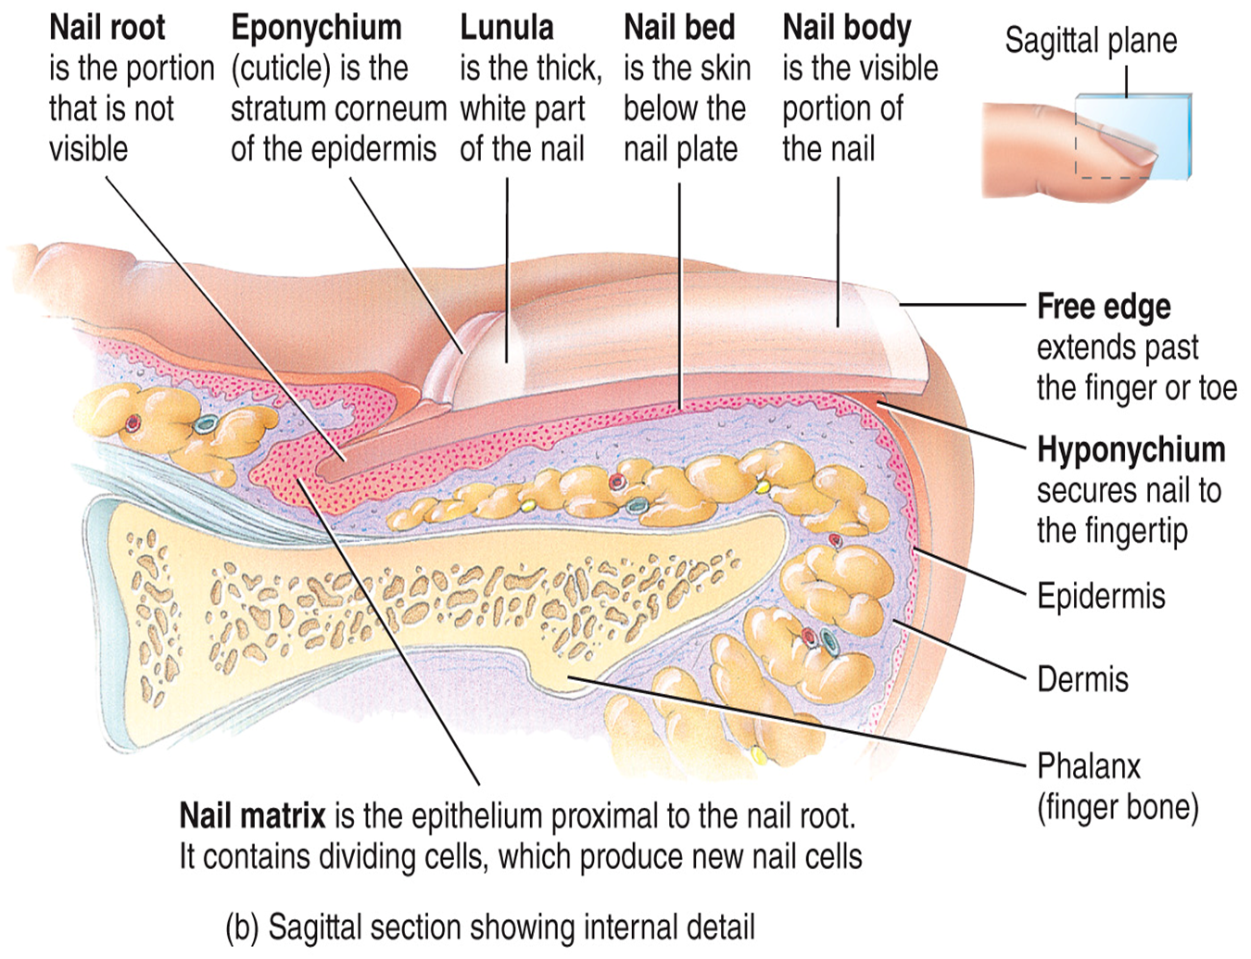
Nails

Slide 33
Functions of Skin

Slide 34
Functions of the Skin
Thermoregulation
Sweat – evaporative cooling
Blood flow to dermis
Blood reservoir
8 – 10% of total blood flow due to abundant blood vessels in dermis

Slide 35
Functions of the Skin
Protection
Keratin
Lipids released by lamellar granules
Sebum
Acidic sweat
Melanin
Macrophages
Cutaneous sensations
Tactile sensations – touch, pressure, vibration, tickle
Thermal sensation – warm, cool
Pain

Slide 36
Functions of the Skin
Excretion and absorption
Elimination of substances from the body and passage of materials from external environment into body cells
Transdermal drug administration
Synthesis of Vitamin D
UV light activates precursor molecule (calcitriol) that allows vitamin D to be produced
Vitamin D aids in absorption of calcium in GI tract

Slide 37
Wound Healing

Slide 38
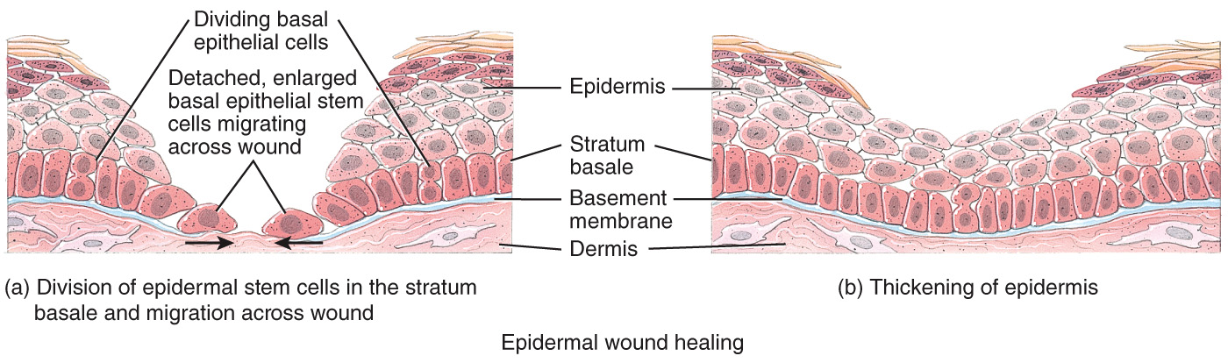
Epidermal Wound Healing
Occurs when superficial wounds affect only the epidermis

Slide 39
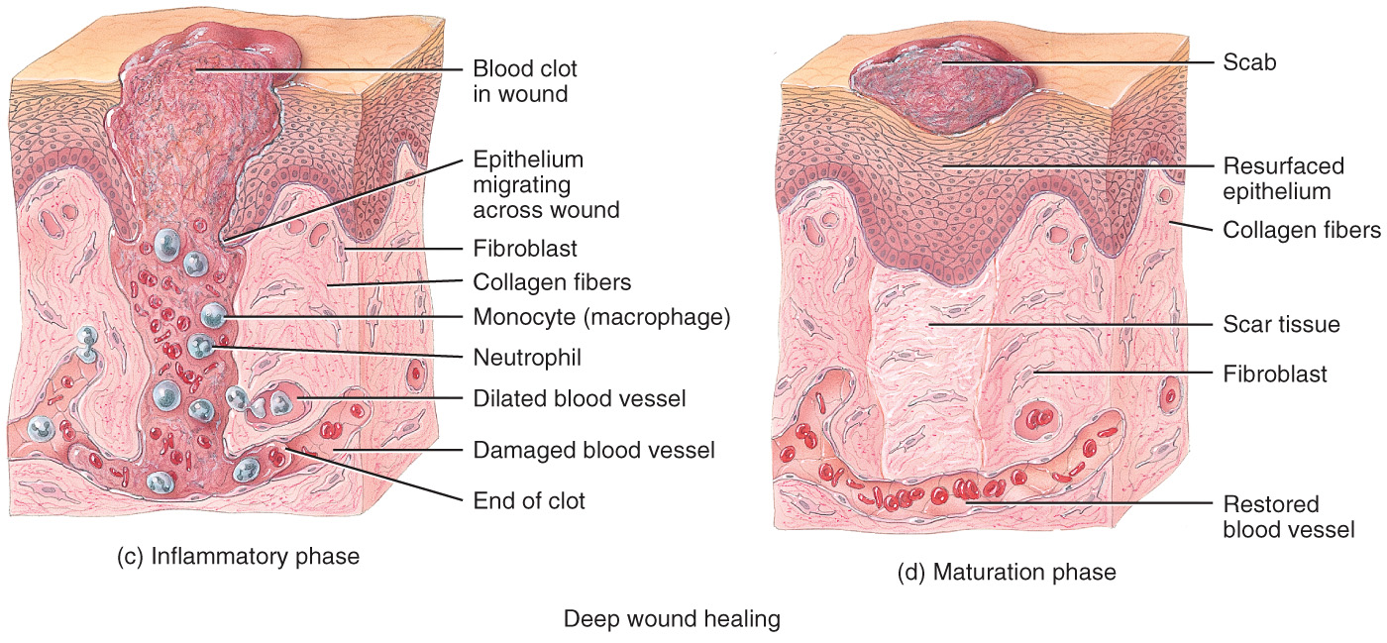
Deep Wound Healing
Additional steps occur when an injury extends into the dermis and subcutaneous layer

Slide 40
Deep Wound Healing
Inflammatory Phase – clot forms
Migratory Phase – clot becomes a scab
Proliferative Phase – growth of epithelial cells beneath scab
Maturation Phase – scab sloughs off once epidermis restored

Slide 41
Development of the Integumentary System

Slide 42
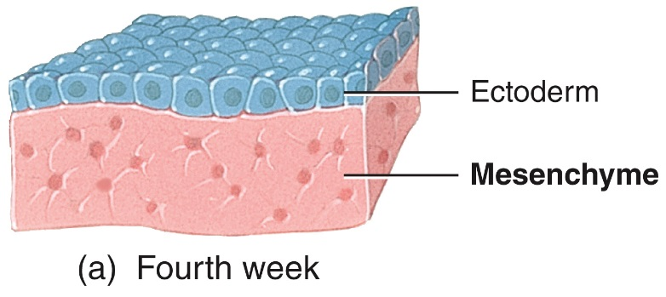
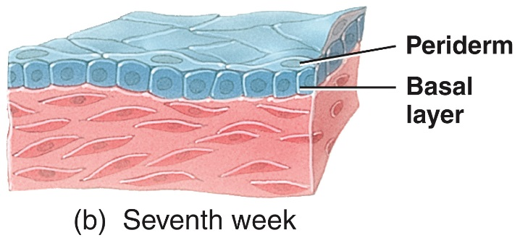
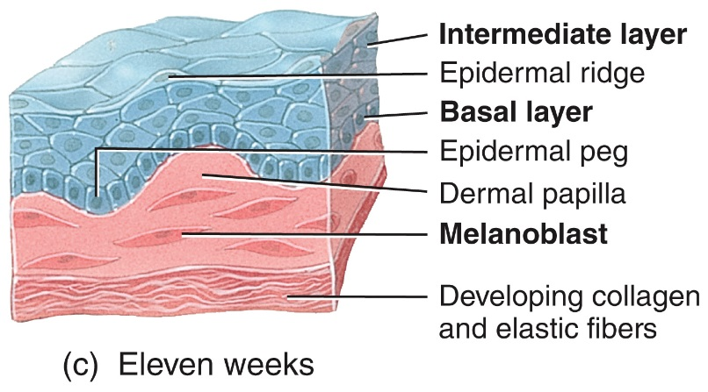
Epidermis Develops from Ectoderm
Nails, hair, and skin glands are epidermal derivatives

Slide 43
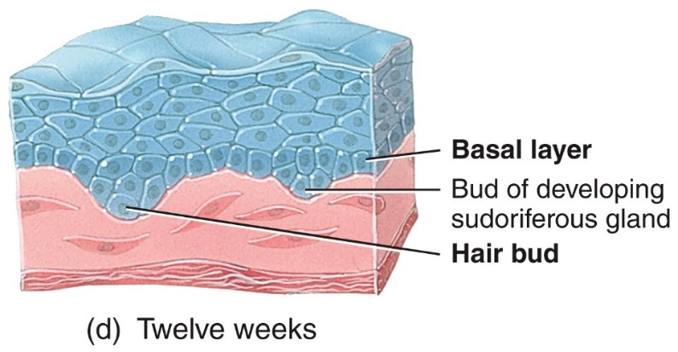
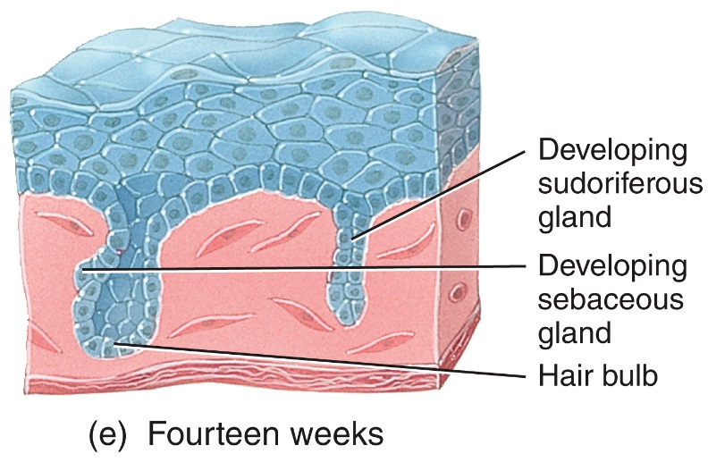
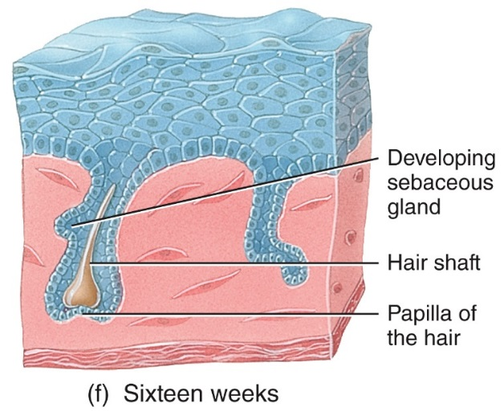
Epidermis Develops from Ectoderm

Slide 44
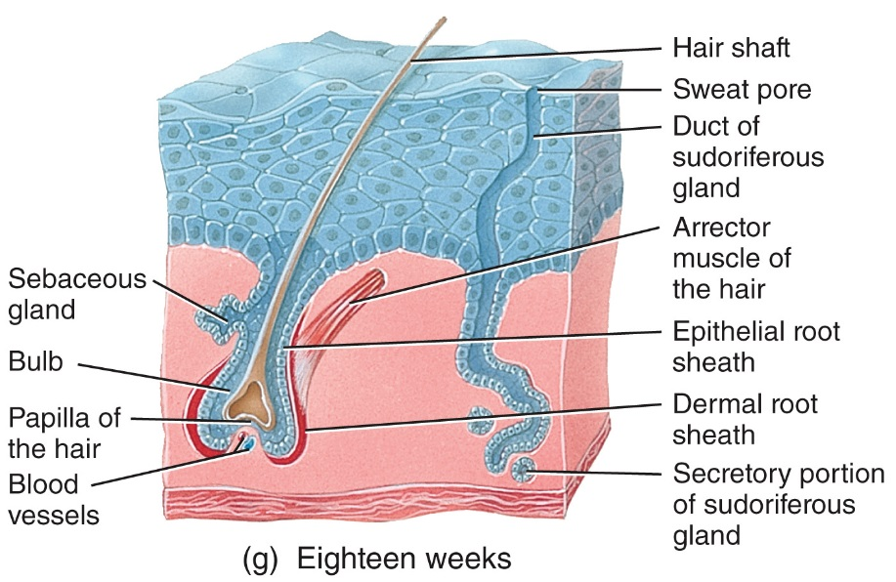
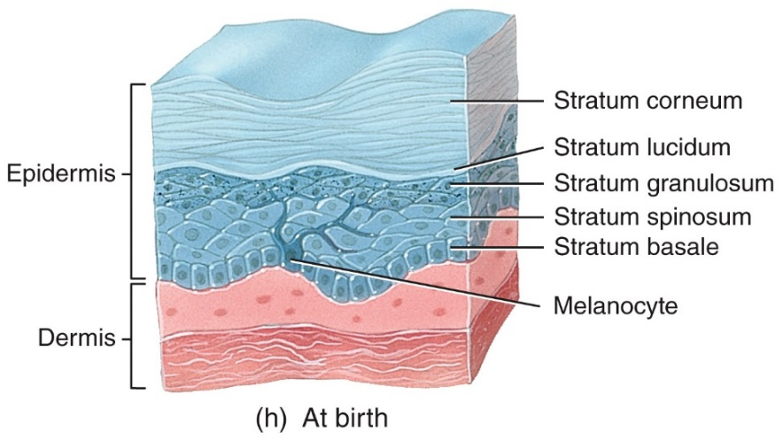
Epidermis Develops from Ectoderm

Slide 45


Dermis Develops from Mesoderm
Mesoderm gives rise to mesenchyme

Slide 46
Aging

Slide 47
Age-Associated Changes
Wrinkles
Dehydration and cracking
Sweat production decreases
The numbers of functional melanocytes decrease which results in gray hair and atypical skin pigmentation
Subcutaneous fat is lost and skin thickness decreases
Nails may become more brittle

Slide 48
Clinical Connection: Skin Cancer
Excessive exposure to ultraviolet light (from the sun or tanning salons) is the most common cause of skin cancer
The three major types are basal cell carcinoma (78%), squamous cell carcinoma (20%) and malignant melanoma (2%)

Slide 49
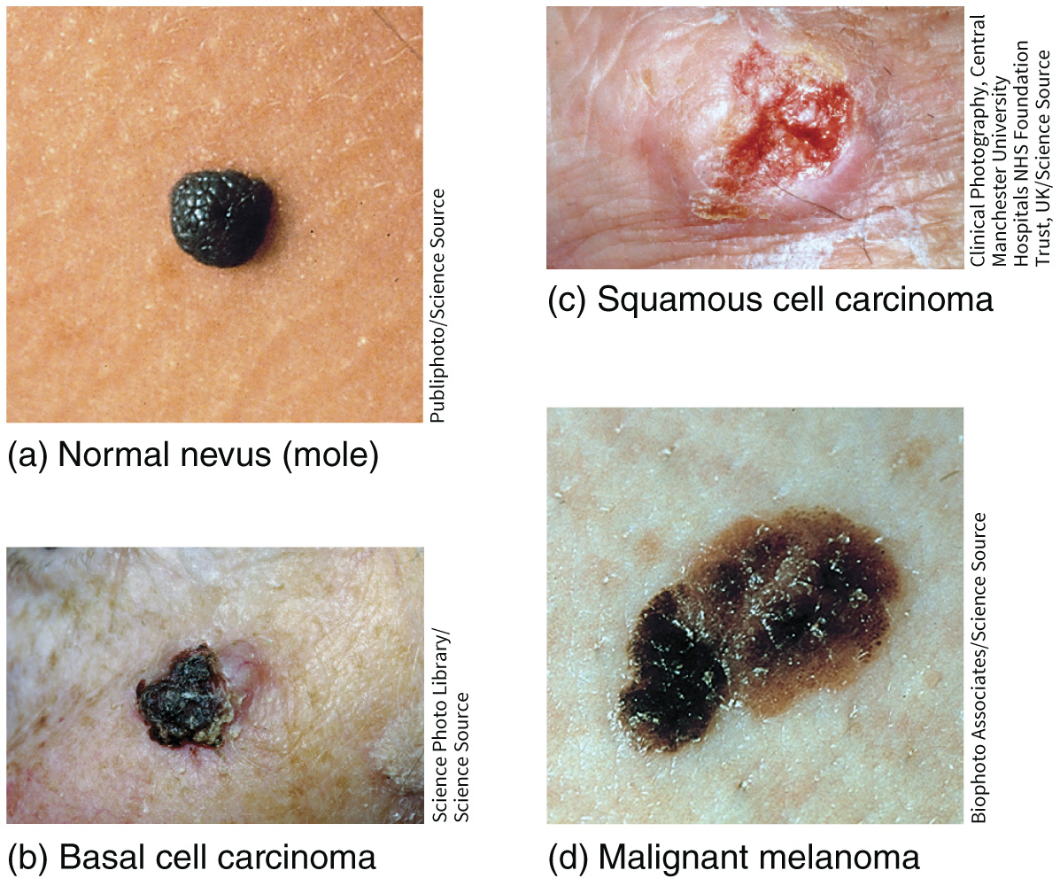
Clinical Connection: Skin Cancer

Slide 50
Clinical Connection: Skin Cancer
Early warning signs of malignant melanoma
A – asymmetry
B – border is irregular
C – color is uneven
D – diameter is >6mm (pencil eraser)
E – evolving and changing in size and shape

Slide 51
Clinical Connection: Burns
A burn is tissue damage caused by excessive heat, electricity, radioactivity, or corrosive chemicals that denature (break down) the proteins in the skin cells
Burns are graded according to their severity

Slide 52
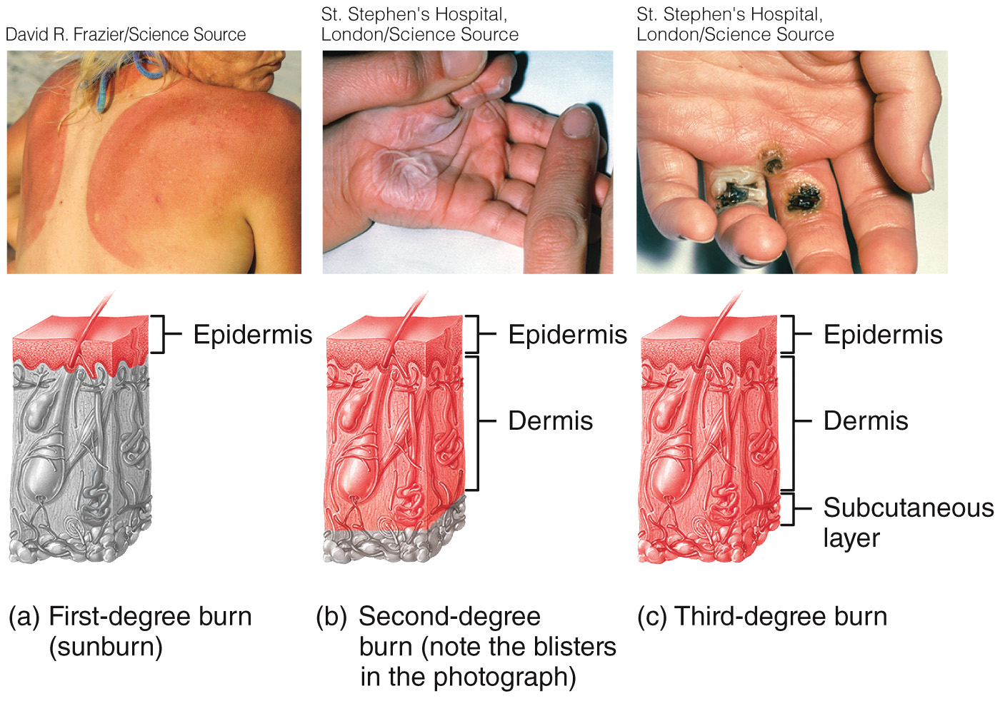
Clinical Connection: Burns

Slide 53
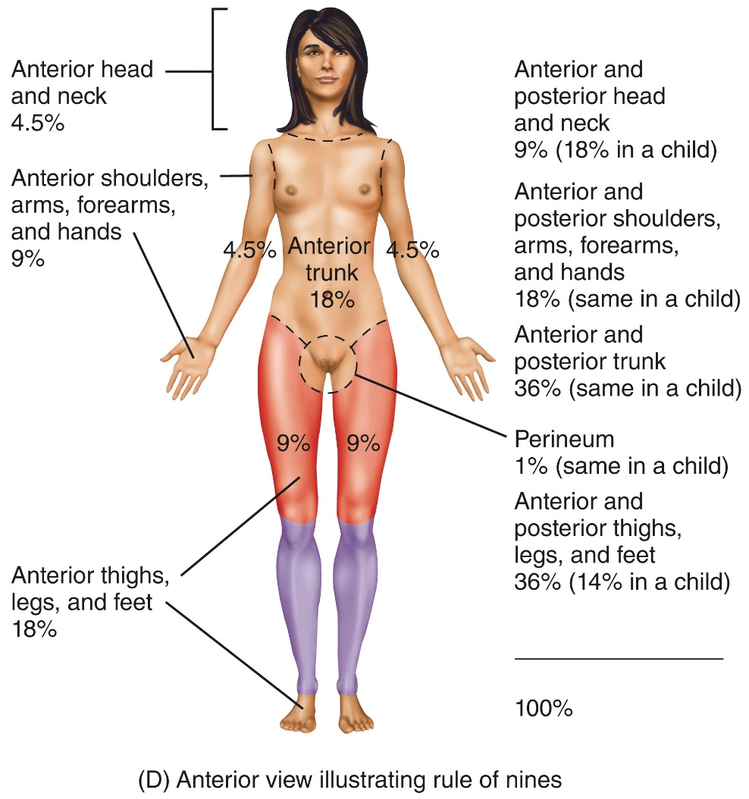
Clinical Connection: Burns
The rule of nines is used to estimate the surface area of an adult affected by a burn

Slide 54
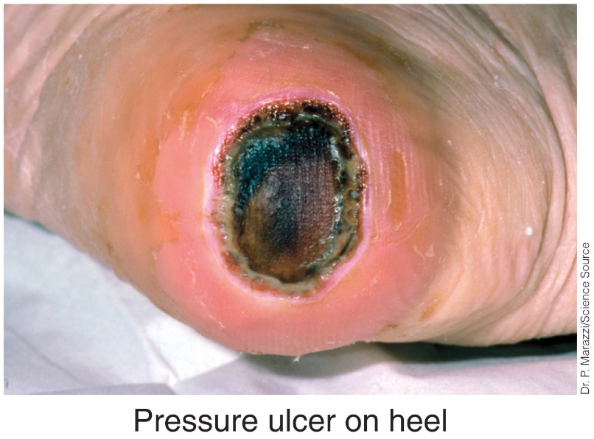
Clinical Connection: Pressure Ulcers
With age, there is an increased susceptibility to pressure ulcers (“bed sores”)
When shedding of epithelium caused by a deficiency of blood flow to tissues occurs, pressure ulcers can develop

Slide 55
Copyright
Copyright © 2021 John Wiley & Sons, Inc.
All rights reserved. Reproduction or translation of this work beyond that permitted in Section 117 of the 1976 United States Copyright Act without the express written permission of the copyright owner is unlawful. Request for further information should be addressed to the Permissions Department, John Wiley & Sons, Inc. The purchaser may make back-up copies for his/her own use only and not for distribution or resale. The Publisher assumes no responsibility for errors, omissions, or damages caused by the use of these programs or from the use of the information contained herein.

